Slide 1

The Rise of Voice Search Optimization in Web Development
IT329

Slide 2

What is Voice Search Optimization?
Definition
"Voice Search Optimization is the process of improving a website’s content, structure, and metadata so that it appears in spoken search results provided by virtual assistants." [1]

Slide 3
Voice search is rapidly becoming a preferred method of searching on mobile and smart devices.
Unlike text-based searches, voice queries are longer, more conversational, and question-based.
Description
Developers must adapt web content to respond to this shift by optimizing for natural language, featured snippets, and structured data. [2]

Slide 4








Over 50% of searches are now done by voice [3].
Why Voice Search Matters
Devices like Google Home, Alexa, and Siri dominate how users retrieve information.[4]
Voice search is faster and more convenient for mobile users.

Slide 5



Examples & Applications of VSO
FAQS WITH CONVERSATIONAL LANGUAGE
Websites use FAQ sections like:
“How can I reset my password?”
For example, a website for a restaurant can include:
“Where’s the best pizza place near me?”
LOCAL SEO & “NEAR ME” SEARCHES
FEATURED SNIPPETS
Web pages written in Q&A format are more likely to be read aloud by Google Assistant.

Slide 6
Tools & Support Libraries for VSO
Google’s Structured Data Markup Helper
Web Speech API (JavaScript)
Answer the Public
SEMrush & Moz Pro
Helps developers add Schema.org tags so that search engines can better understand the page content.
Provides speech recognition capabilities directly in the browser for demo and accessibility purposes.
SEO tools that include voice search analytics and content optimization features.
A keyword research tool that generates real voice-based queries people ask.

Slide 7
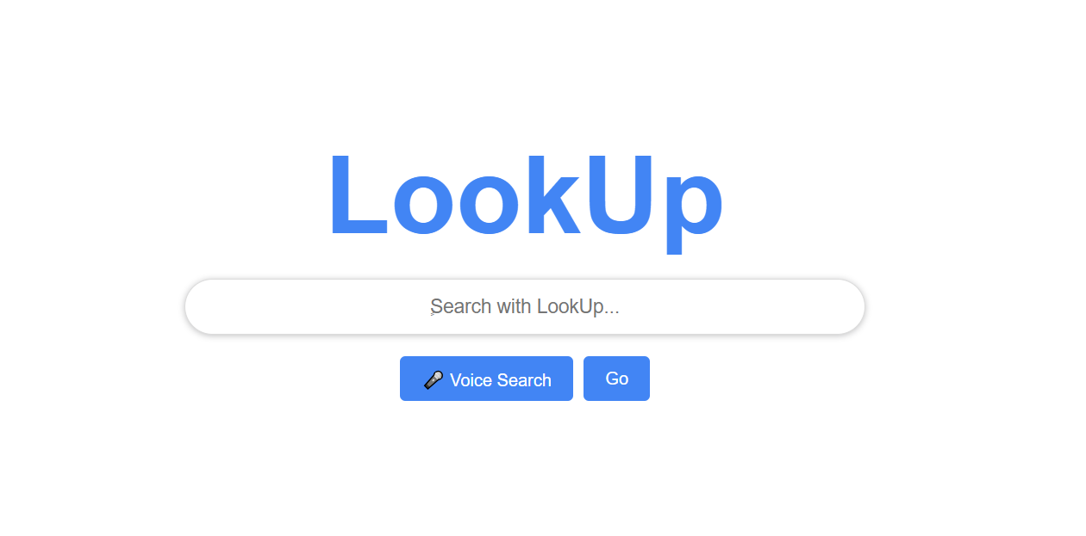
Demo

Slide 8
Voice Search Optimization is crucial for modern web development.
Developers must consider natural language, structured data, and mobile-first designs.
Conclusion
Web Speech API, Structured Data Markup, and keyword analyzers are essential.

Slide 9

Any Questions?

Slide 10

Work Of Students:
Walaa Saif Al-eslam
Maha Albakr
Hatoun Almogherah
Lana Albogami

Slide 11
LinkedIn. (2025). Linkedin.com. https://www.linkedin.com/pulse/voice-search-seo-preparing-future-omoseye-alebiosu
Akhtar, S. (2024, February 6). SEO Secrets Revealed: Techniques for Higher Rankings. https://www.researchgate.net/publication/377981890_SEO_Secrets_Revealed_Techniques_for_Higher_Rankings
Tie Soben. (2025, March 12). Plang Phalla. Plang Phalla. https://plangphalla.com/the-future-is-now-how-digital-marketing-will-wow-you-in-2025/
Biggi, N. (2024, December 27). The Future of Voice Search Optimization: What Businesses Need to Know. The Gorilla Agency – Award Winning | Portland Digital Marketing Agency. https://www.gorillaagency.com/voice-search-marketing/
Goodchild, K. (2020, May 5). Google’s Local Algorithm and Local Ranking Factors - BrightLocal. BrightLocal. https://www.brightlocal.com/learn/local-seo/introduction-to-local-seo/google-local-search-algorithm/
References

